Slide 1
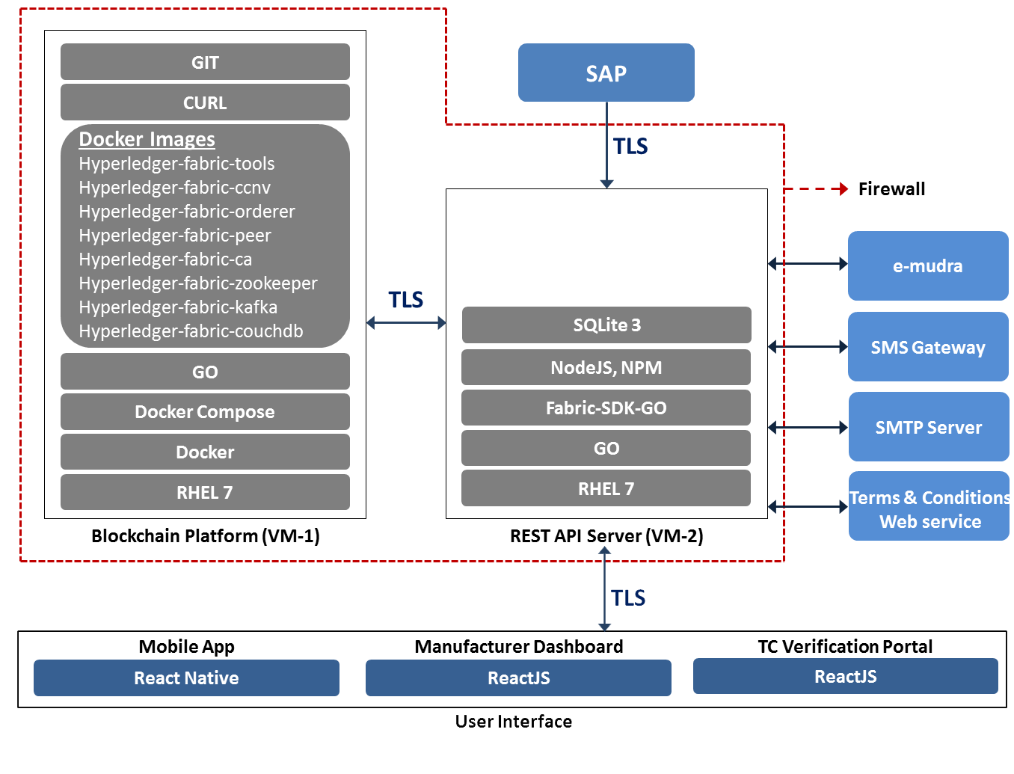
1
1
Fabric Client
2
3

Slide 2
1
Integration with internal system (SAP) from cloud and ports:
TLS
Basic authorisation: (UserID, Password)
Port = 9000
We have shared an URL (https)
TSL pushes data to blockchain layer, we are not accessing SAP
Port used = 9000
Emudra
SMS gateway
SMTP server
Terms & Conditions service
All are outbound call from (Port: 9000, 9001, 9002)
We are not accessing any external services so far.
2
SSL Certificates: TSL has provided SSL certificates. Certificates to be instantiated to both the servers by TSL
3
Communication between the webserver (VM2) and our application (mobile app and browser app)
We are using https for the communication
JWT (JSON Web token) is used to ensure enhanced security
Ports open are 9000, 9001, 9002, 9003.
As no external ports are open in VM1 so with open port of VM2 9003 we are accessing port 5984 (internal port of VM1) for debugging purposes. We are running a proxy server to access port 5984. The proxy server is also listening in https.

Slide 3
At VM2, port open : 9000, 9001, 9002, 9003
At (9003, we are running a proxy server to access port 5984 (couchdb) of VM1 for debugging purpose
Fabric Client: Internal ports written in docker compose.
Internal ports: 7054; 7050; 7051; 7053; 5984; 8051; 8053; 6984; 9051; 9053; 7984; 10051; 10053; 8984

